Slide 1
Bank Management Database System
$
Khushboo Surana

Slide 2
Table of Contents
01
04
02
05
03
06
Nature and Scope
Relational Model
Purpose and Benefits of the Database
SQL Queries
Potential Issues and Measures to Address
Conceptual Data Model and EER Model

Slide 3



Nature and Scope
Customers
The bank serves diverse clients, but our project focuses exclusively on retail banking for individual account holders, providing tailored financial solutions.
Financial Services
Financial services, such as accepting deposits, granting loans, offering savings and checking accounts, managing financial transactions, and providing investment and wealth management services.
Security and Compliance
Bank prioritizes security & regulatory compliance, implementing robust measures to protect customer data and ensure all operations adhere to local and international financial regulations.

Slide 4
Purpose of the Database
To streamline banking operations
To ensure secure and efficient transaction processing
To enhance customer relationship management
To support strategic decision-making

Slide 5
Benefits of the Database
For Customers
Enhanced Customer Service: Facilitates faster response times and personalized services, ensuring customer satisfaction.
Data Security: Ensures the safety and confidentiality of customer information, providing peace of mind for customers.
Improved Reliability: Databases minimize the risk of errors in financial records and fosters trust in the bank's services.
For the Bank
Improved Efficiency: Automates routine tasks, reducing manual workload and errors, leading to cost savings.
Better Decision-Making: Provides real-time data and analytics for informed decisions, improving strategic planning and risk management.
Scalability: A well-designed database system can handle growing amounts of data and increased transaction volumes, supporting the bank's expansion and scalability.

Slide 6
Benefits of the Database
Functionality:
Centralized Data Repository
Real-time Transaction Processing and Monitoring
Customer Relationship Management (CRM) Capabilities
Reporting and analytics tools
Features:
User-Friendly Interface
Data Integration
Scalability
Security Measures
Notes:
I will be discussing the anticipated functionalities and features of our Bank Management Database System, focusing on the benefits it offers.
Functionality:
Centralized Data Repository:
Our database will serve as a centralized repository, ensuring easy access and efficient management of data across the entire bank. This centralization eliminates data silos and provides a single source of truth for all banking operations.
Real-time Transaction Processing and Monitoring:
The system supports real-time transaction processing, allowing us to monitor transactions as they occur. This capability is crucial for ensuring the accuracy and timeliness of financial data, which enhances our operational efficiency and customer service.
Customer Relationship Management (CRM) Capabilities:
Integrated CRM capabilities enable us to manage customer interactions effectively. By leveraging this data, we can enhance customer satisfaction through personalized services and targeted marketing campaigns.
Reporting and Analytics Tools:
Our database includes robust reporting and analytics tools. These tools help in tracking performance and forecasting trends, which are essential for strategic decision-making and long-term planning.
Features:
User-Friendly Interface:
The database is designed with a user-friendly interface that simplifies data entry and retrieval processes. This ease of use is critical for ensuring that all staff members, regardless of technical expertise, can effectively interact with the system.
Data Integration:
It offers seamless data integration, combining data from various sources for comprehensive analysis. This integration ensures that we have a holistic view of our operations and can make well-informed decisions.
Scalability:
The system is highly scalable, supporting growth and accommodating increasing data volumes. This scalability ensures that our database can grow alongside our business needs without compromising performance.
Security Measures:
Implementing robust security measures, the database uses encryption and access controls to protect sensitive information. This security is vital for maintaining the integrity and confidentiality of our data, which is especially important in the banking sector.
In conclusion, our Bank Management Database System is designed to enhance efficiency, improve customer service, and support our strategic goals through its comprehensive functionalities and features.
Thank you for your attention.

Slide 7






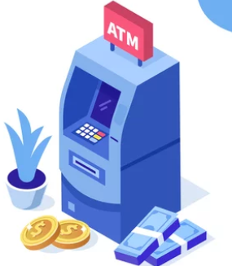





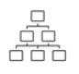


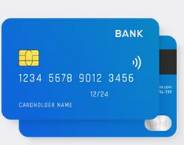



Conceptual Data Model (EER)
Entities
Customer Service Request
Account Type
Branch Manager
Notification
Customer Feedback
Transaction
ATM
Customer
Investment Banking
Account
Department
Branch
Employee
Locker
Reports
Loan Payment
Loan
Card Details
Other Banks

Slide 8
Entity-Relationships
Each Customer can hold multiple Accounts. Each Account is held by one Customer.
Each Customer can request multiple Customer Service actions. Each Customer Service action is requested by one Customer
Each Customer can have multiple Loans. Each Loan is held by one Customer
Each Account Type can include multiple Accounts. Each Account belongs to one Account Type
Each Transaction occurs in one Account. Each Account can have multiple Transactions
Each Branch manages multiple Employees. Each EMPLOYEE is managed by one Branch.
Each Branch operates multiple Lockers. Each Locker is operated by one Branch
Each Branch hosts multiple ATMs. Each ATM is hosted by one Branch.
Each Branch has multiple Departments. Each Department belongs to one Branch
Each Loan includes multiple Loan Payments. Each Loan Payment is part of one Loan
Each Investment Banking account belongs to one Customer. Each Customer can have multiple Investment Banking accounts
Each Employee can write multiple Reports. Each Report is written by one Employee

Slide 9
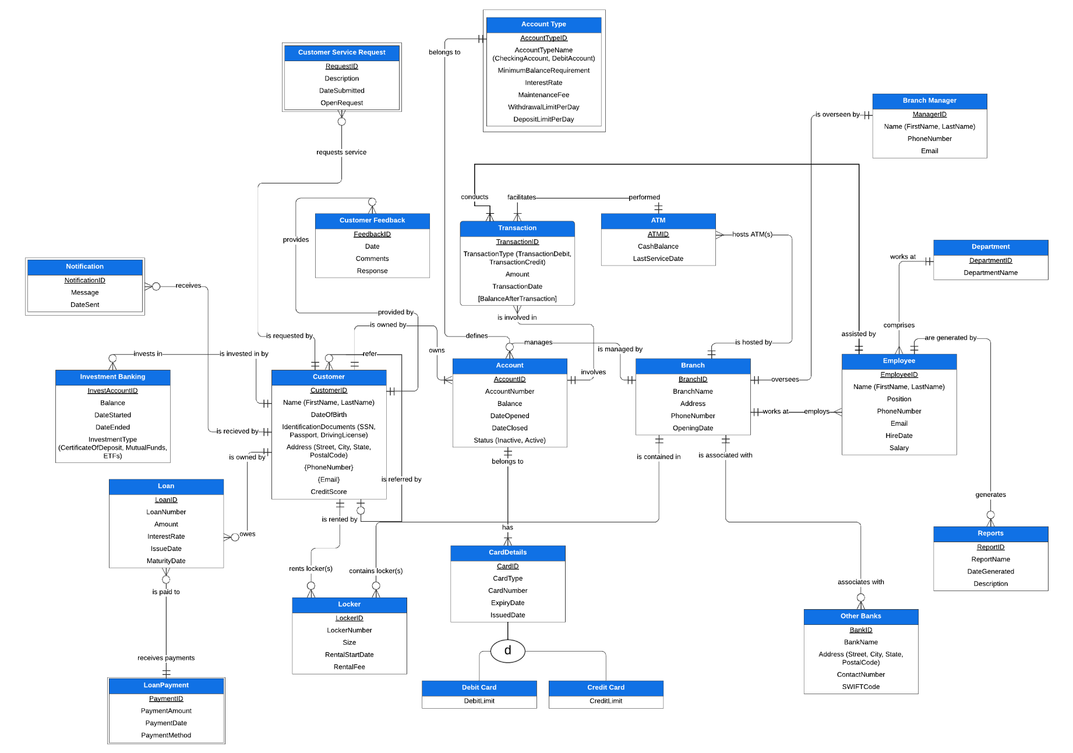
EER
Weak Entity
Weak Entity
Associative Entity
Composite Attribute
Composite Attribute
Is associated with
Unary Relationship
Multivalued Attributes
includes
Super and Subtype
Disjointed Constraints
Weak Entity
Notes:
Notification Entity cannot exist without Customer Entity
Name consists for First and Last Name, hence it is a Composite Attribute
Customer can have multiple phone numbers and email IDs - hence they are multivalued attributes
Card can either be debit or credit card (disjoint subtypes)
Transaction connects Account to ATM and hence is an Associate Entity

Slide 10
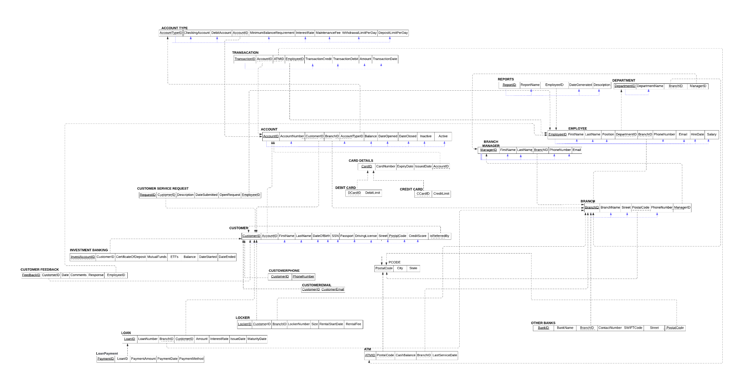
Since ‘BalanceAfterTransaction’ is derived, it need not be stored in Transaction
Composite Attribute Name(FirstName & LastName)
Multivalued attributes (Phone, Email) into separate tables
Normalisation by creating separate relation

Slide 11
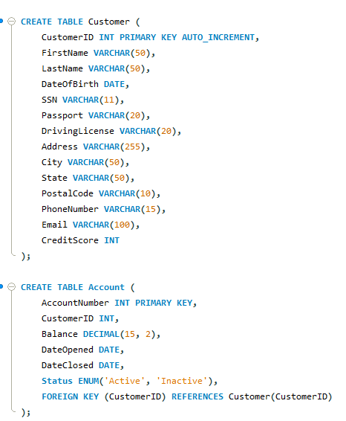
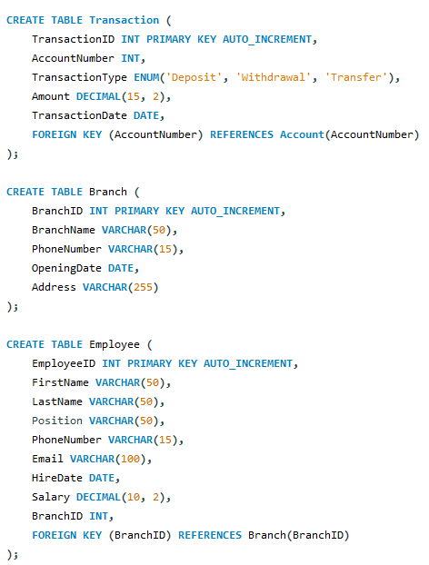
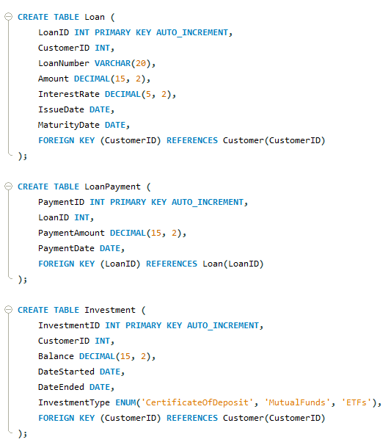
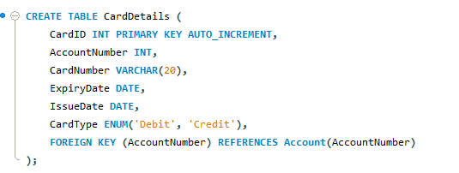
SQL Database - Table Creation

Slide 12
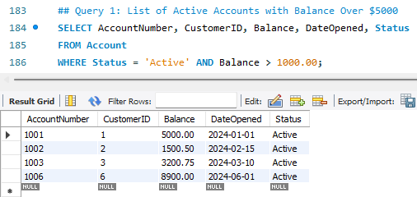
SQL Database - SQL Queries

Slide 13
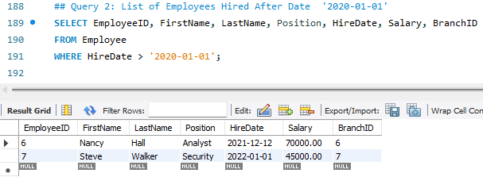
SQL Database - SQL Queries

Slide 14
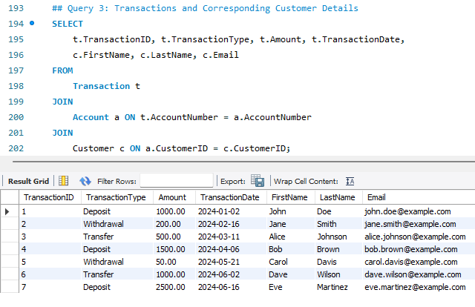
SQL Database - SQL Queries

Slide 15
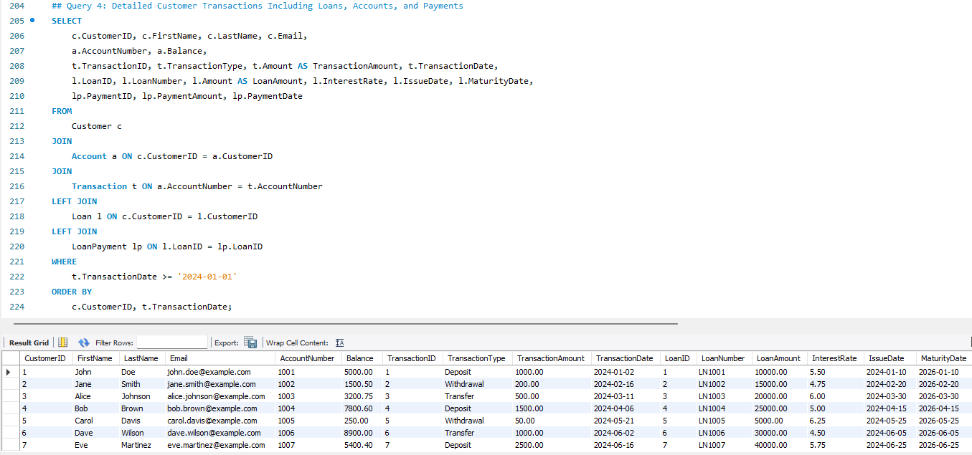
SQL Database - SQL Queries

Slide 16
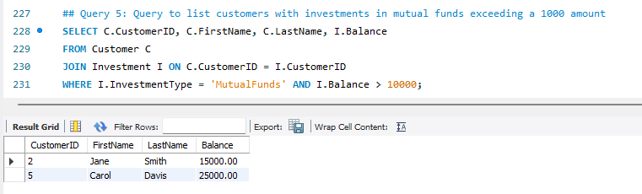
SQL Database - SQL Queries

Slide 17
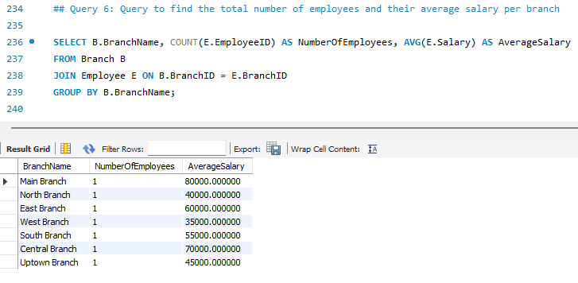
SQL Database - SQL Queries

Slide 18
Potential Issues and Measures to Address Them
Data Integrity Issues
Potential Issues:
Inconsistent or duplicate data entries
Loss of data integrity due to incorrect or unauthorized data modifications
Measures:
Normalization: Ensuring the database is normalized to avoid data redundancy and maintain data integrity.
Foreign Key Constraints: Enforcing referential integrity between tables to ensure that relationships between data are maintained correctly.
Unique Constraints: Implementing unique constraints on key fields to prevent duplicate entries.
Data Security and Privacy Concerns
Potential Issues:
Unauthorized access to sensitive customer information
Data breaches
Non-compliance with data protection regulations
Measures:
Role-Based Access Control (RBAC): Implementing RBAC to ensure that users only have access to the data necessary for their roles.
Encryption: Encrypting sensitive data both at rest and in transit to protect against unauthorized access.
Audit Trails: Maintaining detailed logs of all database transactions and access to monitor and detect suspicious activities.

Slide 19
Potential Issues and Measures to Address Them
Performance and Scalability
Potential Issues:
Slow query performance
System downtime
Inability to handle large volumes of data or high transaction rates
Measures:
Indexing: Using appropriate indexes on frequently queried columns to speed up data retrieval.
Database Partitioning: Partitioning large tables to improve performance and manageability.
Load Balancing: Implementing load balancing to distribute the workload across multiple servers.
Backup and Recovery
Potential Issues:
Data loss due to system failures, accidental deletions, or other unforeseen events
Measures:
Regular Backups: Performing regular backups of the database to ensure data can be restored in case of loss.
Recovery Plans: Establishing and regularly testing disaster recovery plans to ensure the database can be quickly restored to normal operations after an incident.

Slide 20
Thank You!
$
$

